Slide 1
Employee Performance Analysis Using Excel
PRESENTED BY: THARUN RAJAN P
REGISTER NO.: 312204540
DEPARTMENT: COMMERCE
COLLEGE: K.C.S KASI NADAR COLLEGE OF ARTS AND SCIENCE

Slide 2
PROJECT TITLE
Employee Performance Analysis Using Excel

Slide 3
AGENDA
1.Problem Statement
2. Project Overview
3.End Users
4.Our Solution and Proposition
5. Dataset Description
6. Modelling Approach
7. Results and Discussion
8.Conclusion

Slide 4
PROBLEM STATEMENT
The data shows a range of performance ratings (1-5) across employees in similar roles (Area Sales Manager), suggesting inconsistency in performance assessment criteria or potential discrepancies in evaluation.
Employees are classified under various employee types (Contract, Temporary, Part-Time, Full-Time) and pay zones, raising questions about the impact of these classifications on performance and job satisfaction.
The employees hold similar titles but different job functions (e.g., Administrator, Lineman, Director, Laborer, Technician, Project Manager). This variation may influence their performance ratings and job roles, leading to a need for a better understanding of job function impact.
Employees come from varied demographic backgrounds (gender, race), which could affect performance ratings and organizational culture. Understanding this diversity is crucial for equitable assessment and management.
The status of employees (Active) and their respective termination types (if any) might affect their performance ratings and job stability. Exploring these relationships could provide insights into workforce management and retention strategies.

Slide 5
PROJECT OVERVIEW
[Employee Performance Improvement and Pay Zone Optimization]
To analyze performance discrepancies and identify factors contributing to varying performance scores and ratings among Area Sales Managers.
Examine employee performance ratings in relation to their business unit, job function, employment type, and demographic details to understand the underlying patterns and disparities.
Investigate the evaluation criteria and methods used for performance ratings to ensure consistency and fairness across different managers and departments.
Assess how different employment statuses (e.g., Full-Time vs. Part-Time) affect employee performance and overall team efficiency.
Explore how demographic factors (e.g., gender, race) impact performance ratings and if any biases are present.
Develop recommendations for improving performance evaluation processes, addressing potential biases, and standardizing criteria to enhance overall employee satisfaction and performance consistency.

Slide 6
WHO ARE THE END USERS?
Human Resources (HR) Department
Department Managers (Sales & Production)
Senior Leadership/Executives
Employees
Finance/Compensation Teams

Slide 7
OUR SOLUTION AND ITS VALUE PROPOSITION
Filtering - Remove missing values.
Conditional Formatting - Blanks, Background Color Shading, Data Bars, Values.
Data Filtering and Sorting - Identify specific employee performance groups, such as those with exceeds, needs improvement and fully meets.
Pivot table - Summary of employee performance under their employee Id.
Graphs - Final Report with Trend line.

Slide 8
DATASET DESCRIPTION
EMPLOYEE ID: Unique identifier for each employee in the organization.
FIRST NAME: The first name of the employee.
Current Employee Rating: The current rating or evaluation of the employee's overall performance
Performance Score: A score indicating the employee's performance level (e.g., Excellent, Satisfactory, Needs Improvement).
Business Unit: The specific business unit or department to which the employee belongs.

Slide 9
MODELLING
DATA SET: Kaggle, Employee dataset.
FEATURE SELECTION: Slicer, Conditional Formatting, Designing.
DATA CLEANING: Missing values, Irrelevant data, Correct Errors, Remove Unnecessary Columns and Rows.
PIVOT TABLE: Employee ID, First Name, Performance Score.
CHART: Report of Employee Performance based on their Employee Id is represent in Values and Performance Score presented as Column Chart.

Slide 10
RESULTS

Slide 11
CONCLUSION
The analysis revealed significant performance discrepancies among employees in similar roles, indicating potential issues with the evaluation process or management practices.
methods.
Key areas for improvement include refining performance evaluation criteria, enhancing fairness in ratings, and addressing any discrepancies caused by employment status or demographic factors.
Implement the recommendations to improve performance management practices, monitor the impact of changes, and continuously assess and adjust strategies to foster a fair and productive work environment.
analysis may reveal inconsistencies in performance ratings based on job functions, classifications, and demographics, suggesting areas for standardization in performance evaluation.
Understanding how different employee classifications affect performance can guide adjustments in classification policies and improve job role alignment.

Slide 12
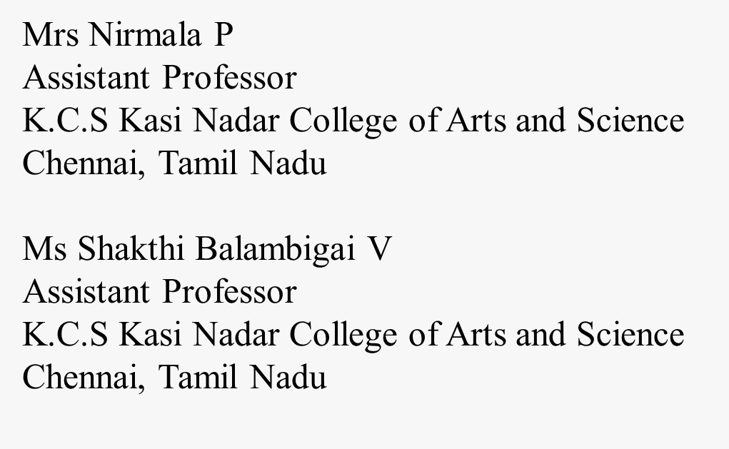
REFERENCE

